Slide 1


Brown Bag - Nerf Gun Turret

Slide 2
Hackathon
2 day event Dec 10 – 11, 2015
Work on anything – doesn’t have to be work related

Slide 3

Ideas…
Something to combine hardware and software …. control the physical world with software
Inexpensive
Fun
How about a Nerf gun turret?

Slide 4
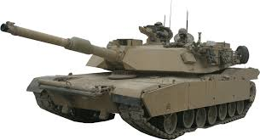
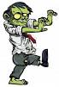
Nerf Gun Turret?

Slide 5
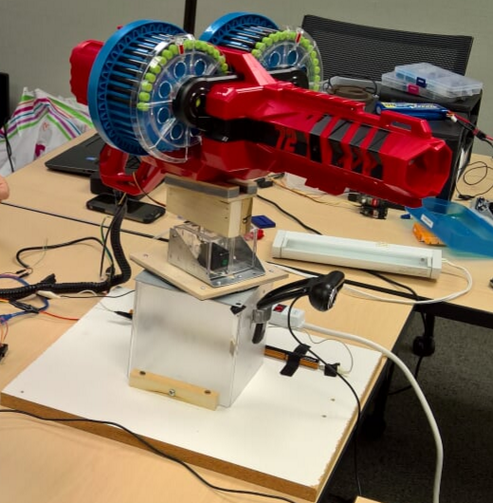
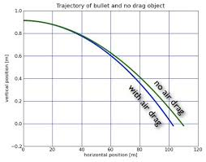
Nerf Gun Turret
Nerf gun placed on a swiveling platform
Autonomously Track and Engage a moving target.

Slide 6
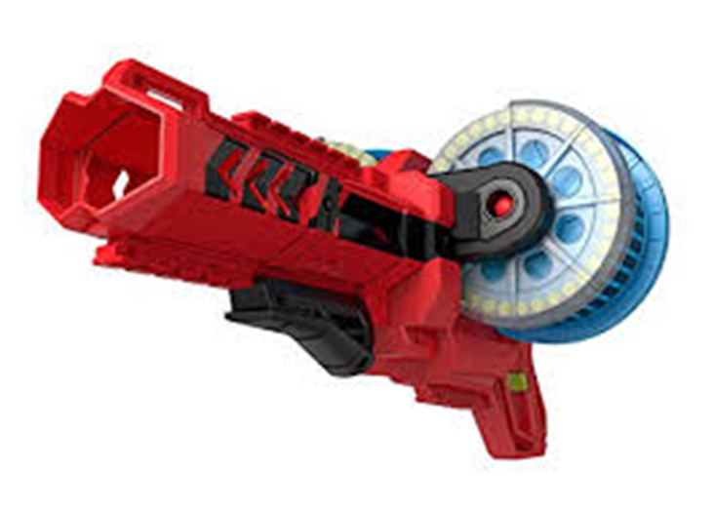
Nerf Gun Turret := gun + swivel platform + electronics
BOOMco Colossal Blitz
Dual – 36 Dart magazine
Fire rate of 5 darts / second
Can use a computer to pull the triggers

Slide 7
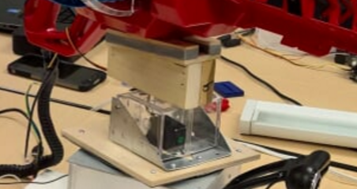
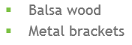
Nerf Gun Turret := gun + swivel platform + electronics
180 degree rotation
< 1 second to rotate to target
Inexpensive parts found at hardware store
Bolts/screws
Duct Tape

Slide 8
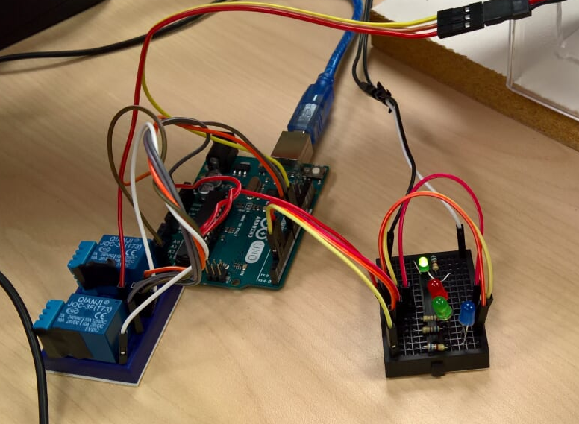
Nerf Gun Turret := gun + swivel platform + electronics
Arduino Uno – miniature computer / microcontroller
2 Relays (electro-magnetic switches) – clicking noise from car blinkers
A bunch of LEDs and resistors

Slide 9
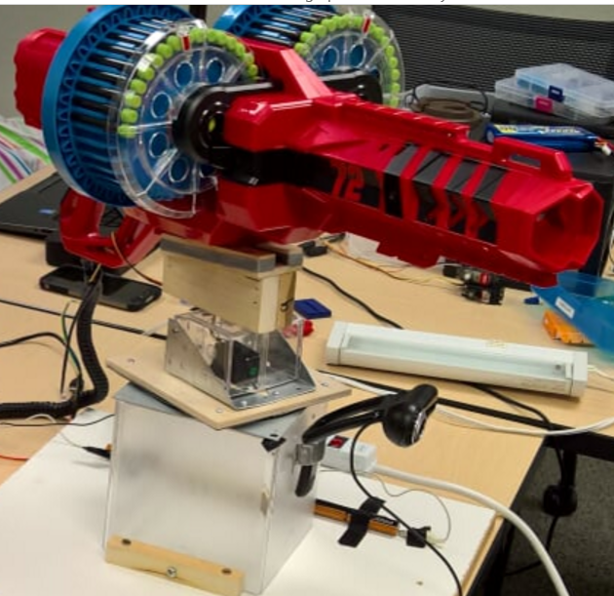
Building The Gun
Steps:
Modify gun to allow Arduino to pull the trigger
Build a swivel platform (turret)
Wire the gun and turret to the Arduino
Write Arduino code to control the gun/turret
Write .net code to talk to the Arduino and camera
Notes:
From here on out we’ll use hands-on demonstrations to show each step.
Main focus will be on the hardware and how to use software to control our physical world.

Slide 10
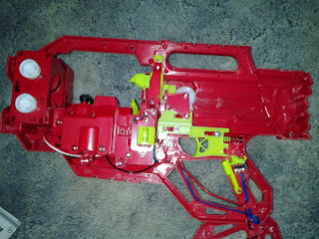
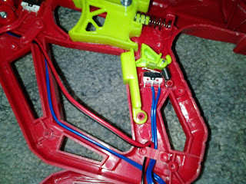
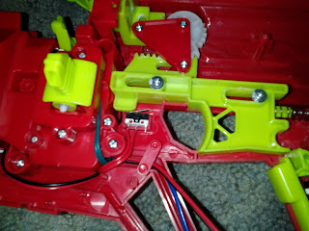
Step 1: Modifying the gun – Demo by John
Find the battery connections
Find the switch for the flywheel
Find the switch for the trigger

Slide 11
Step 2: Building the Turret - Demo
Angled wood to hold the gun
Servo attached to Lazy Susan to spin the gun
Large flat wood base to support everything

Slide 12
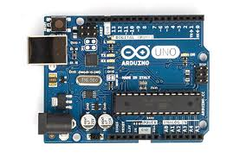
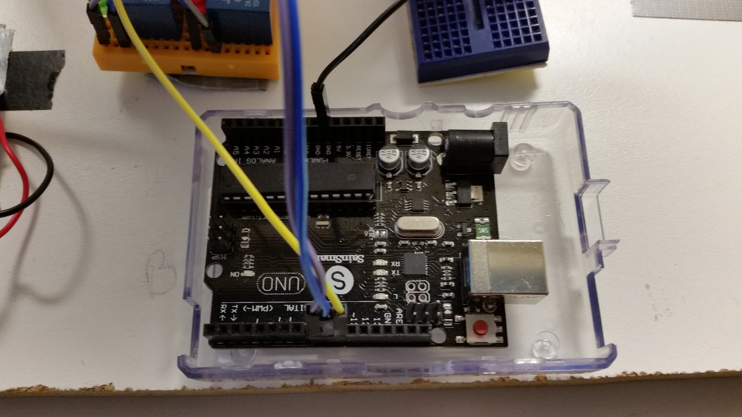
What is an Arduino Uno?
Arduino Uno [ar – dweeno] – a microcontroller (really small computer) used to interface with digital and analog devices.
In our case, we’re interfacing with two relays and a servo – through the digital interface.

Slide 13
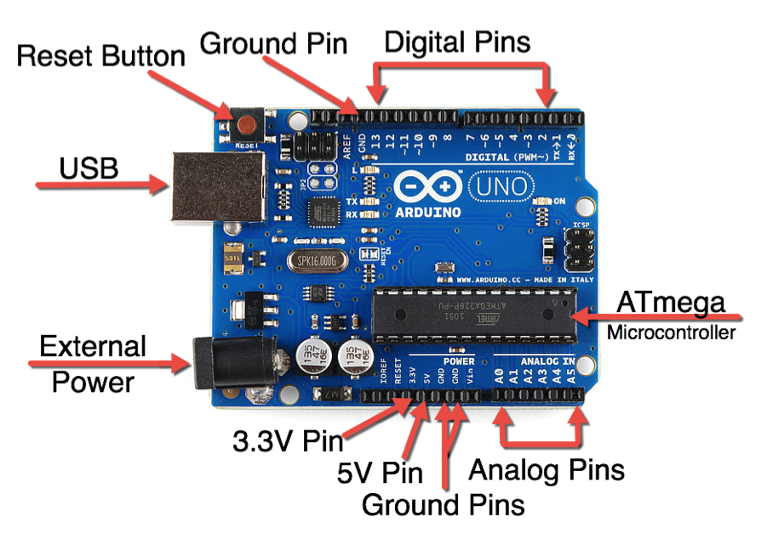
Anatomy of an Arduino Uno

Slide 14
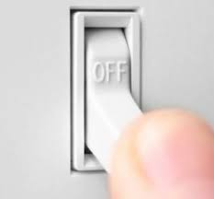
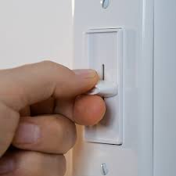
Digital? Analog? I’m confused…
Digital
Think light switch
Only two states: ON or OFF
Analog
Think light dimmer – ON, OFF, and a bunch of variations in-between

Slide 15
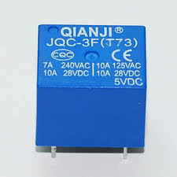
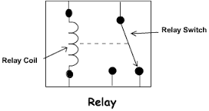
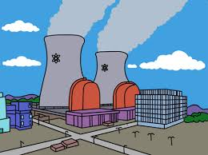
Relay - Digital Switch
Acts like a light switch. Allowing you to use a small amount of power to switch on a large amount of power.
State is either on or off.
Protects the Arduino from large amounts of power
5V DC

Slide 16
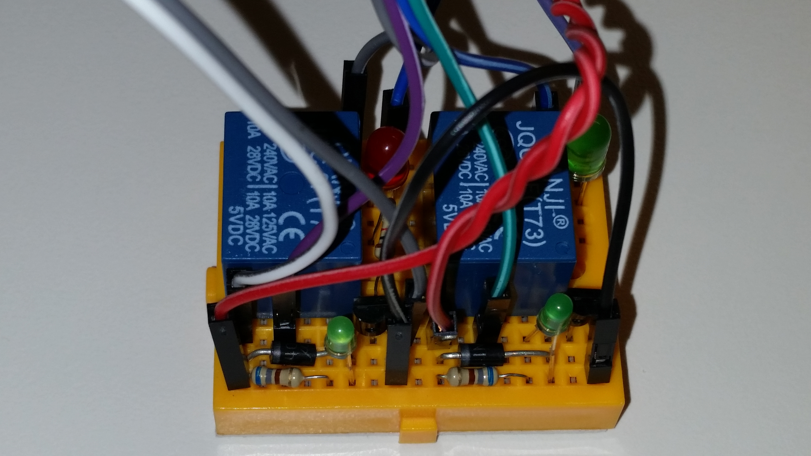
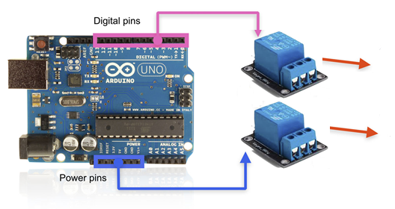

Step 3a: Connecting the Relays - Demo

Slide 17
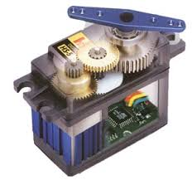
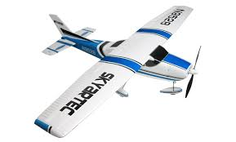
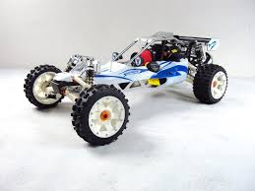

Step 3b: Connecting the Servo - Demo
A servo is a small motor attached to gears that takes a digital signal and converts it into a rotational position.
A servo will turn to a position usually between 0 and 180 degrees.
They are used in RC cars, boats, and planes to turn the wheels/rudder/aileron

Slide 18
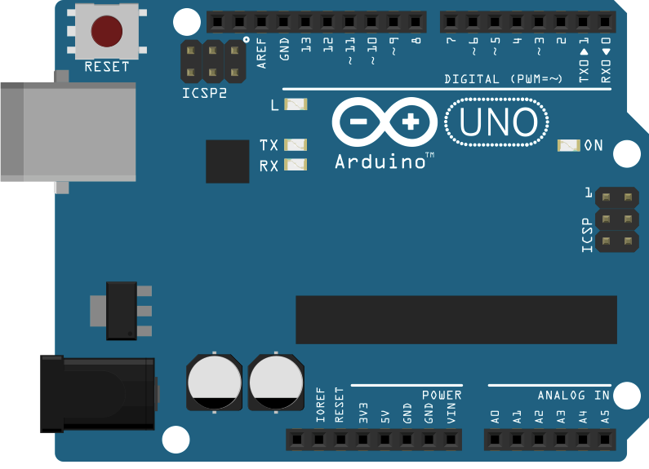
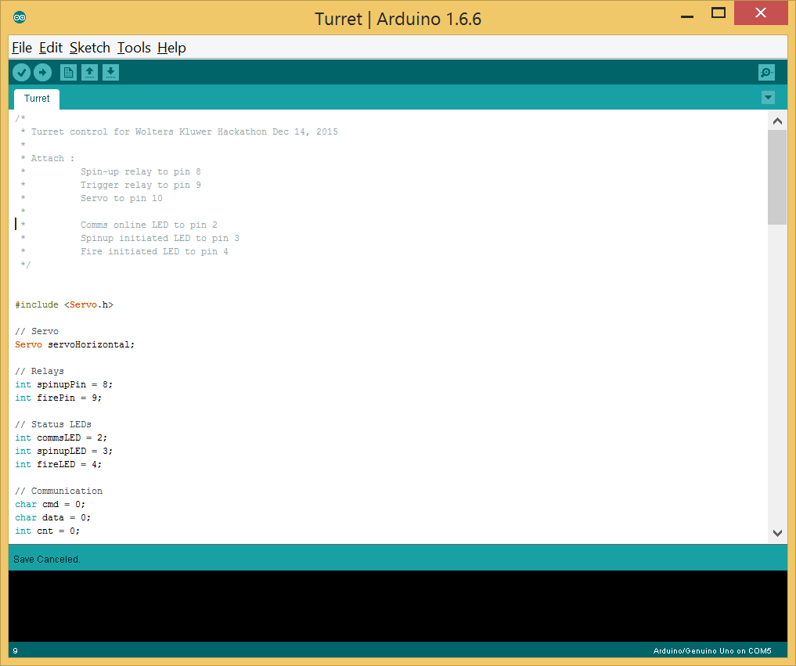
Step 4: Programming the Arduino - Demo
Arduino IDE used to write C’ish code to talk to the digital and analog pins of the Arduino
Talks to the Arduino through the USB port
10’s of thousands of code examples online
Huge community of developers/hackers
Notes:
Pull up a blank app and develop the turret code.
Talk through the development as you #include libraries, declare global level objects, place code in Setup(), and loop().

Slide 19
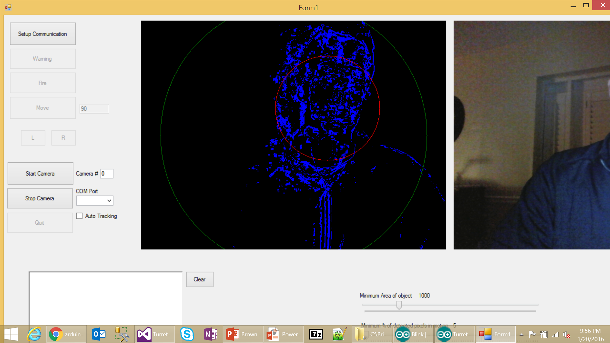
Step 5: Programming the .net code - Demo
Web camera uses EmguCV for vision processing
An open source computer vision processing library
Facial recognition, motion capture, license plate recognition, pedestrian detection, shape detection, stitching, video surveillance, OCR.
Xbox Controller uses J2i.Net.XInputWrapper.
Serial communication to the Arduino through the System.IO.Ports .SerialPort class
Notes:
Image capture line 268
Xbox Controller line 427
COM Port ArduinoController.cs line 26

Slide 20
Demo of the gun
Notes:
Pull up a blank app and develop the turret code.
Talk through the development as you #include libraries, declare global level objects, place code in Setup(), and loop().

Slide 21
What Peripherals are Available for the Arduino?
Digital
Mechanical (relay, servo, stepper motor, DC motor)
Home security (motion sensor, window/door break sensor)
Analog
Weather sensors (temp, humidity, barometric pressure)
Biometric (fingerprint, muscle, heart rate, pulse, pH, neural)
Environment (CO, alcohol, methane, LPG, dust, hydrogen, radiation)
Light/Imaging (UV, RGB, luminosity, CMOS, webcam, laser distance)
Infrared (FLIR, proximity, IR emitter/detector)
Communication / Serial
Cell/GPRS, WiFi, Ethernet, Bluetooth, RF (315 MHz to 2.4 GHz ) with ranges exceeding 10km, Serial

Slide 22
Resources
https://www.arduino.cc/ Official web page for Arduino
https://www.sparkfun.com/ Online retailer
https://www.adafruit.com/ Online retailer
http://www.emgu.com/wiki/index.php/Main_Page
https://github.com/jjoyner/xinput-wrapper/blob/master/J2i.Net.XInputWrapper.sln

